Slide 1
Kim
HEEWON
Permutation Matrices

Slide 2
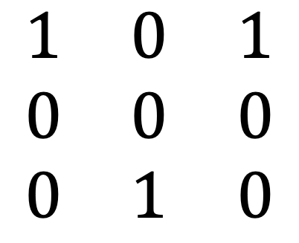
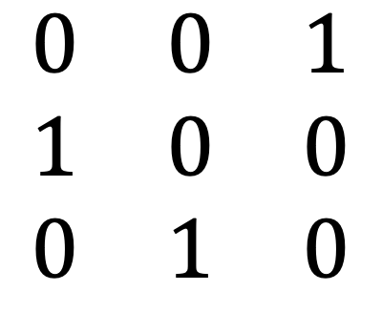
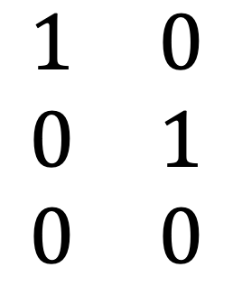
About Permutation Matrices
Enjoy your stylish business and campus life with BIZCAM
Permutation Matrix is a square matrix made up of only ones and zeros and each row and column have exactly one 1
$$\begin{matrix}0 & 0 & 1 \\ 1 & 0 & 0 \\ 0 & 1 & 0\end{matrix}$$
$$\begin{matrix}1 & 0 & 1 \\ 0 & 0 & 0 \\ 0 & 1 & 0\end{matrix}$$
$$\begin{matrix}1 & 0 \\ 0 & 1 \\ 0 & 0\end{matrix}$$
Permutation Matrix
Not Permutation Matrix
Not Permutation Matrix
Two ones exist at row1
Matrix is not a square

Slide 3
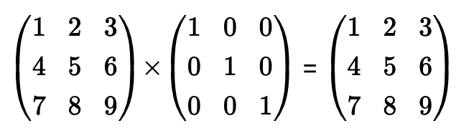
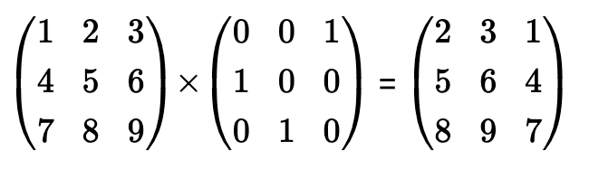
About Permutation Matrices
Enjoy your stylish business and campus life with BIZCAM
Permutation matrices are similar to the identity matrix in that when you multiply by it, the values don’t change
Permutation matrices are different to the identity matrix in that they rearrange the rows or the columns of the matrix.
identity matrix
Permutation matrices

Slide 4
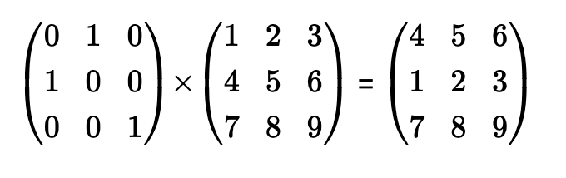
How to use Permutation Matrices
Enjoy your stylish business and campus life with BIZCAM
𝑃 × 𝐴 is a row permutation
• This will rearrange the rows of A
If 𝑃 is a row permutation matrix,
Then, if 𝑃𝑖.𝑗 = 1, row 𝑗 is moved to row 𝑖
𝑝1,2 = 1, so row 2 goes to row 1
𝑝2,1 = 1, so row 1 goes to row 2
𝑝3,3= 1, so row 3 goes to row 3

Slide 5
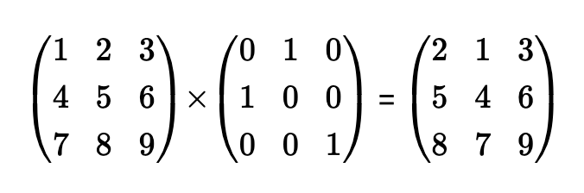
How to use Permutation Matrices
Enjoy your stylish business and campus life with BIZCAM
𝐴 × 𝑃 is a column permutation
• This will rearrange the columns of A
If 𝑃 is a column permutation matrix,
Then, if 𝑃𝑖,𝑗 = 1, column 𝑖 is moved to column j
𝑝1,2 = 1, so column 1 goes to column 2
𝑝2,1 = 1, so column 2 goes to column 1
𝑝3,3= 1, so column 3 goes to column 3

Slide 6
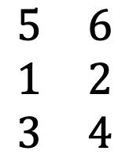
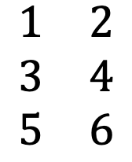
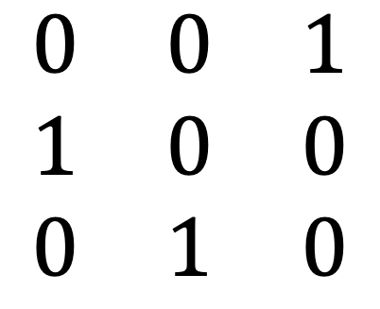
Example
Enjoy your stylish business and campus life with BIZCAM
Question.
$$\begin{matrix}1 & 2 \\ 3 & 4 \\ 5 & 6\end{matrix}$$
$$\begin{matrix}5 & 6 \\ 1 & 2 \\ 3 & 4\end{matrix}$$
create a matrix product which results in the matrix
Solution
1. Rows have been rearranged, so we are looking for P × A
2. Since A is (3 × 2) , so since P is square P is a (3 × 3)
3.
row 1 goes to row 2, So 𝑝2,1 = 1
row 2 goes to row 3, So 𝑝3,2 = 1
row 3 goes to row 1, So 𝑝1,3 = 1
$$\begin{matrix}0 & 0 & 1 \\ 1 & 0 & 0 \\ 0 & 1 & 0\end{matrix}$$
So P =

Slide 7
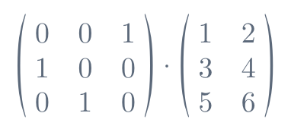
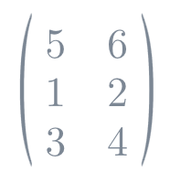
Example
Enjoy your stylish business and campus life with BIZCAM
Question.
$$\begin{matrix}1 & 2 \\ 3 & 4 \\ 5 & 6\end{matrix}$$
$$\begin{matrix}5 & 6 \\ 1 & 2 \\ 3 & 4\end{matrix}$$
create a matrix product which results in the matrix
To recalculate separately to see if a calculation is correct or incorrect
=

Slide 8
SongJaeMin
Software
19011653
PA= LU Factorization

Slide 9
What is PA=LU Factorization and how to apply
This is the matrix This is the matrix formulation of elimination with partial pivoting.
The PA= LU factorization is the established workhorse for solving systems of linear equations.
The PA= LU factorization is simply the LU factorization of a row-exchanged version of A.
instead of putting only a zero in the eliminated position, we have made the zero a storage location.
Inside the zero at the (𝑖,𝑗) position, we store the multiplier 𝑚𝑖𝑗 that we used to eliminate that position
You can easily perform LU decomposition using the numbers written in place of 0
and the numbers obtained by performing partial pivoting.

Slide 10
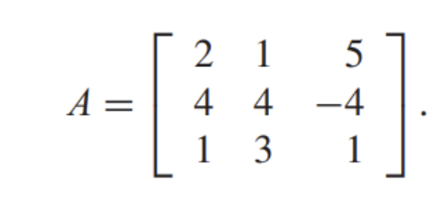
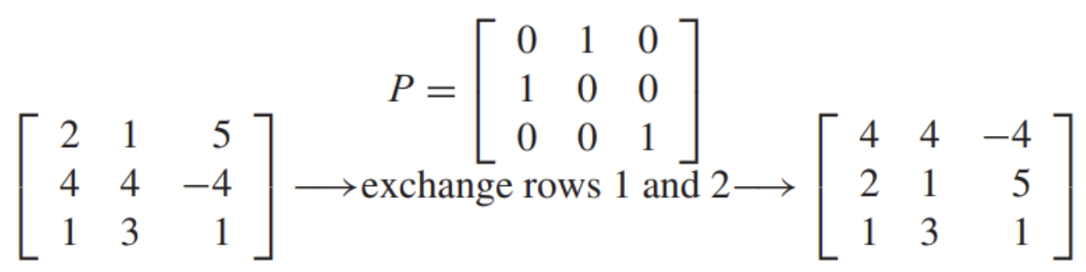
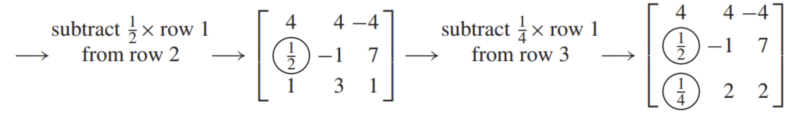
Let’s do the following PA=LU Factorization.

Slide 11
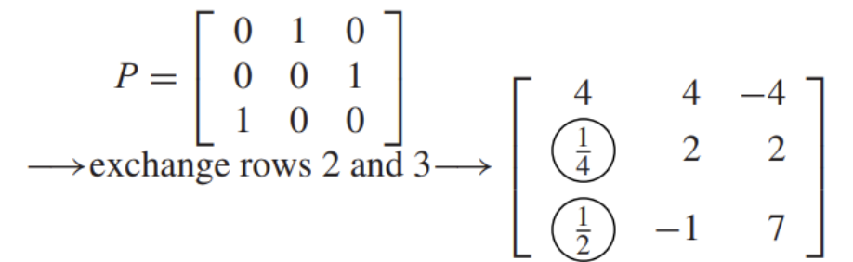
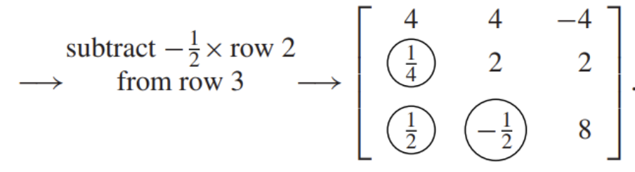
Let’s do the following PA=LU Factorization.

Slide 12
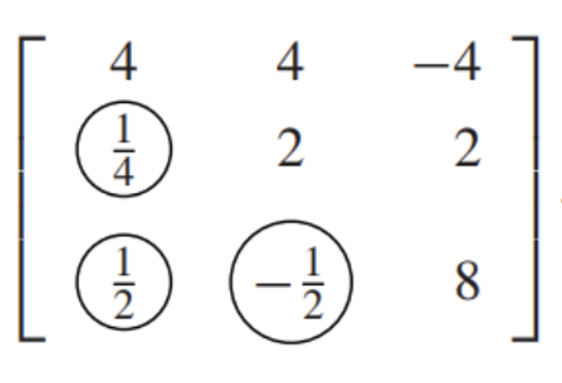
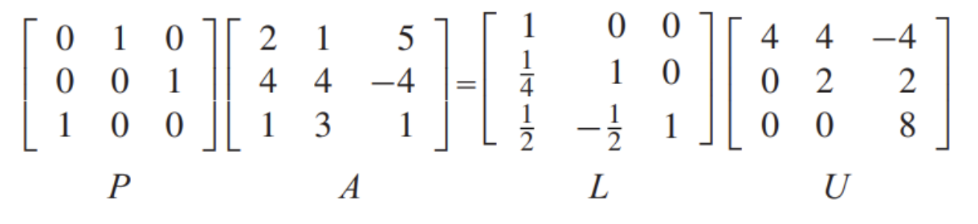
Let’s do the following PA=LU Factorization.

Slide 13

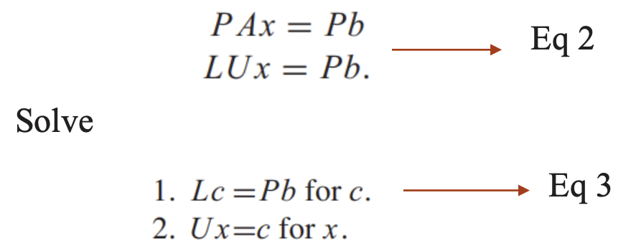
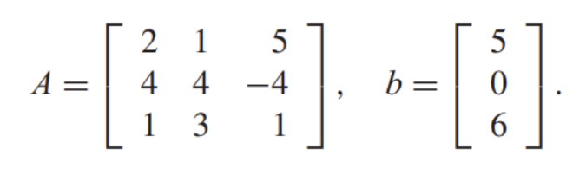
Let’s solve linear equation

Slide 14
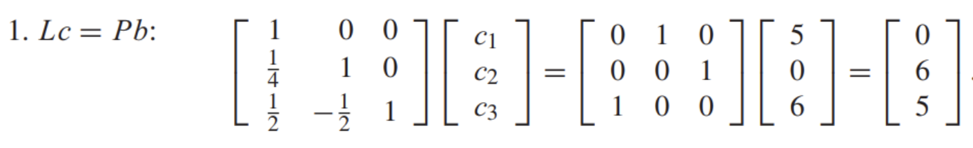
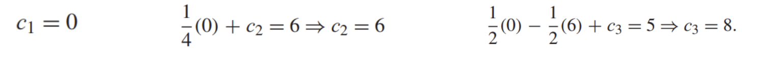
Let’s solve linear equation

Slide 15
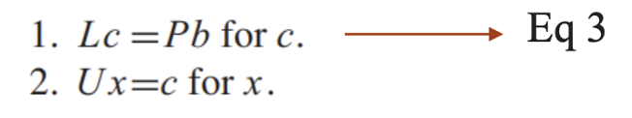
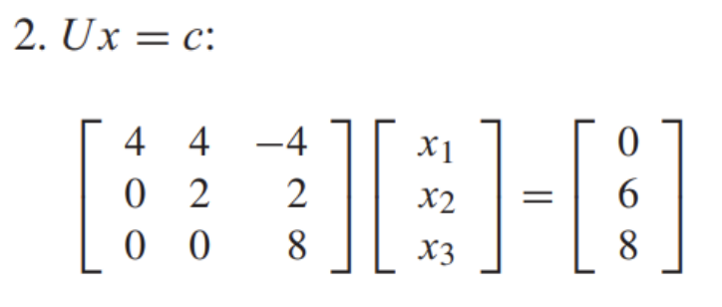
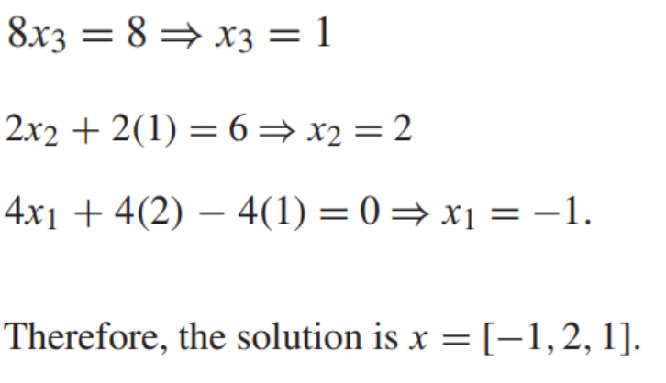
Let’s solve linear equation

